Slide 1

CoffeeHouse App Design
Preet Sharma

Slide 2
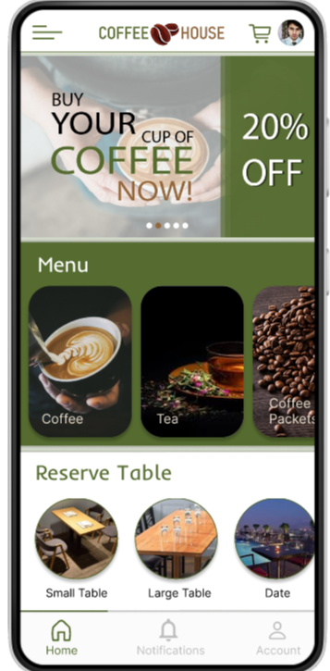
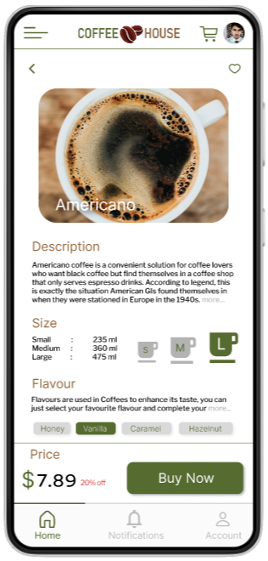
Project overview
The product:
CoffeeHouse is a store which offers variety of coffees, teas, and other beverages. They provides product delivery services for 24x7 and have a reserve table option for advance table booking in the store. CoffeeHouse target customers are students and workers.
Project duration:
May 2022 to July 2022.

Slide 3
Project overview
The problem:
Busy students and workers who works till late night needs a cup of coffee.
The goal:
Design an app for CoffeeHouse that allows users to easily order and pick up fresh, warm coffee.

Slide 4
Project overview
My role:
UX designer designing an app for CoffeeHouse App from conception to delivery and reservation.
Responsibilities:
Conducting interviews, paper and digital wireframing, low and high-fidelity prototyping, conducting usability studies, accounting for accessibility, and iterating on designs.

Slide 5
User research
Personas
Problem statements
User journey maps
Understanding
the user

Slide 6
User research: summary
I conducted interviews and created empathy maps to understand the users I’m designing for and their needs. A primary user group identified through research was working adults and students who need coffee at anytime.
This user group confirmed initial assumptions about CoffeeHouse customers, but research also revealed that users not only need coffee during night hours but they also prefer to order coffee during their working hours.

Slide 7
User research: pain points
1
2
3
4
Time
Accessibility
Table Booking
IA
Working adults are too busy to spend time on coffee prep
Platforms for ordering food are not equipped with assistive technologies
It’s difficult to stand in long queues to wait for empty table in store
Text-heavy menus in apps are often difficult to read and order from

Slide 8
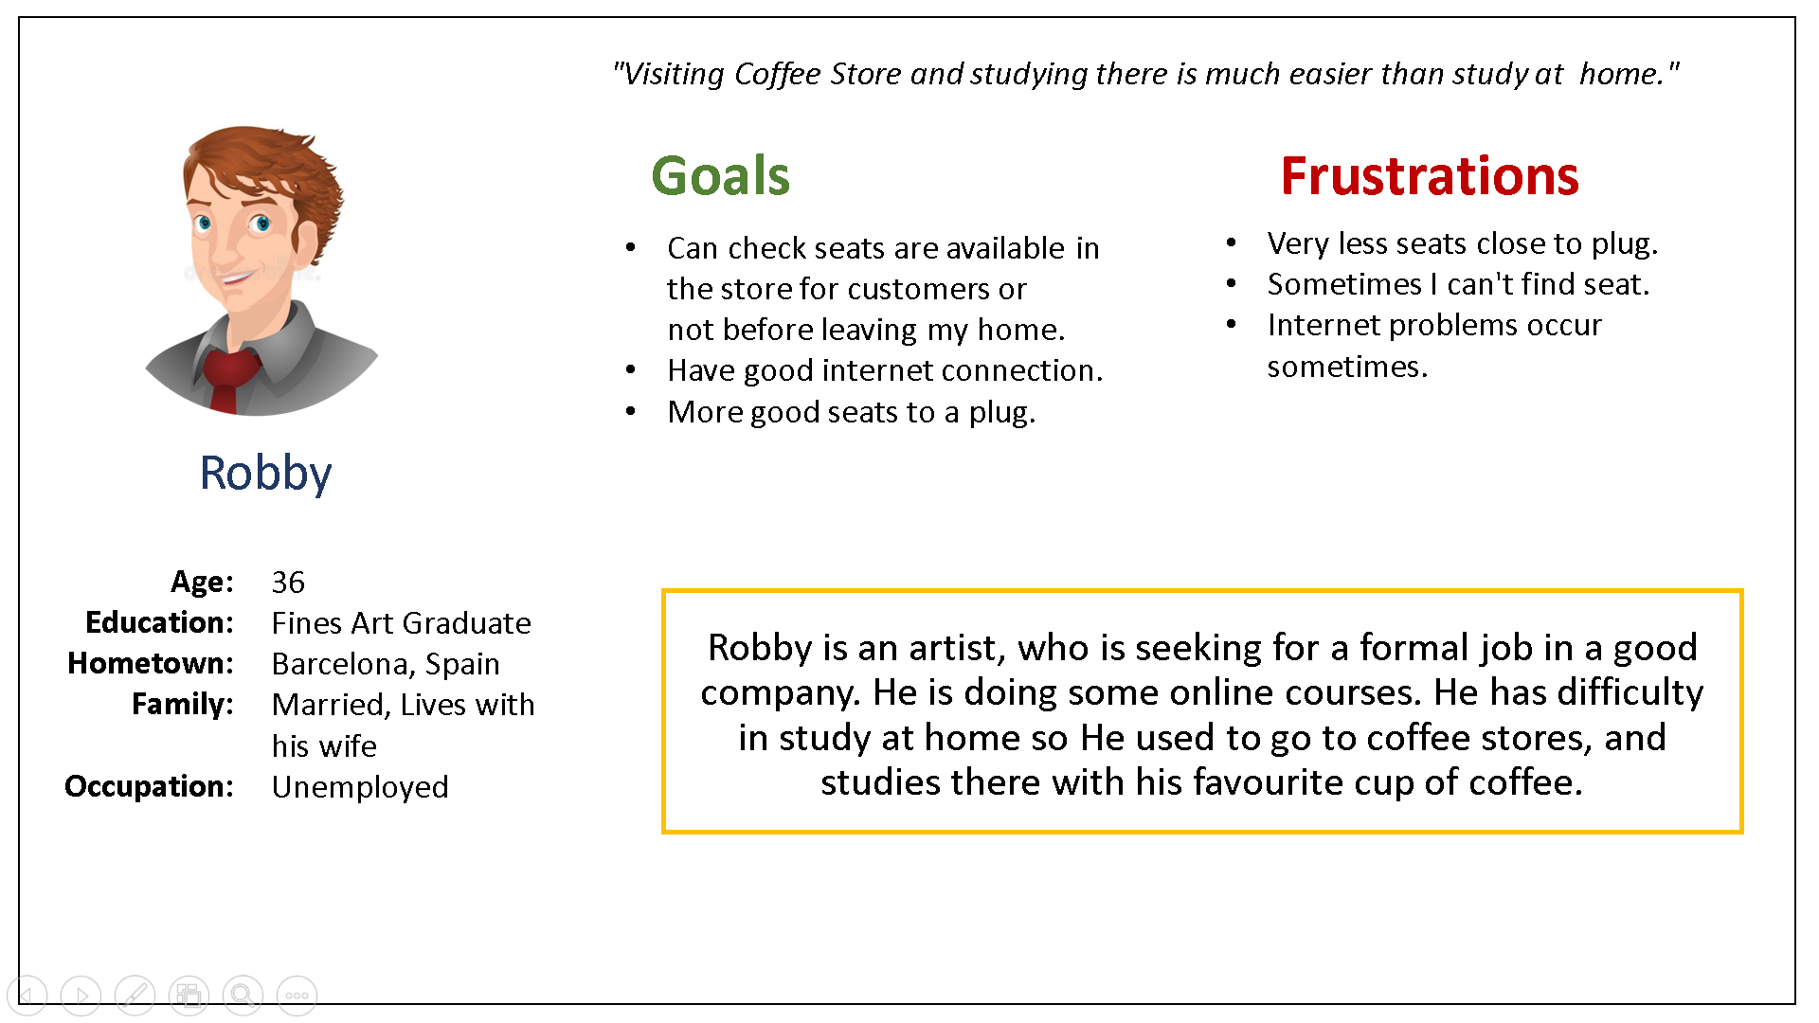
Persona: Robby
Problem statement:
Robby is artist who needs a app from which he can easily see the table booking option of coffee store because sometimes he has to stand in long queues for empty table.

Slide 9
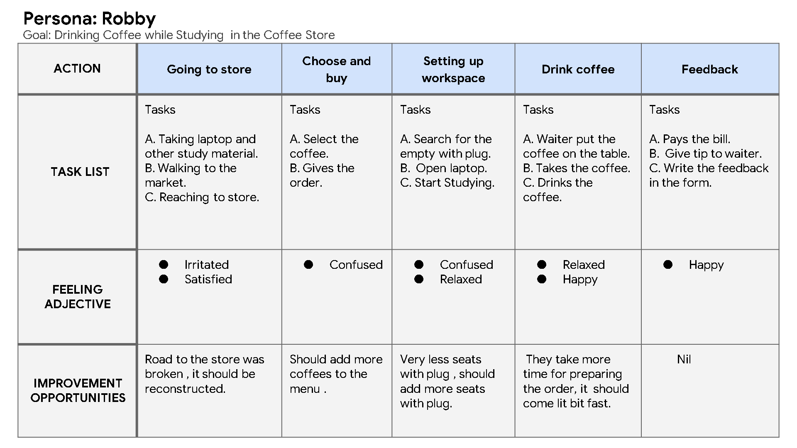
User journey map
Mapping Robby’s user journey revealed how helpful it would be for users to have access to a dedicated CoffeeHouse app.
Image of user journey map

Slide 10
Paper wireframes
Digital wireframes
Low-fidelity prototype
Usability studies
Starting
the design
Paper wireframes
Digital wireframes
Low-fidelity prototype
Usability studies

Slide 11
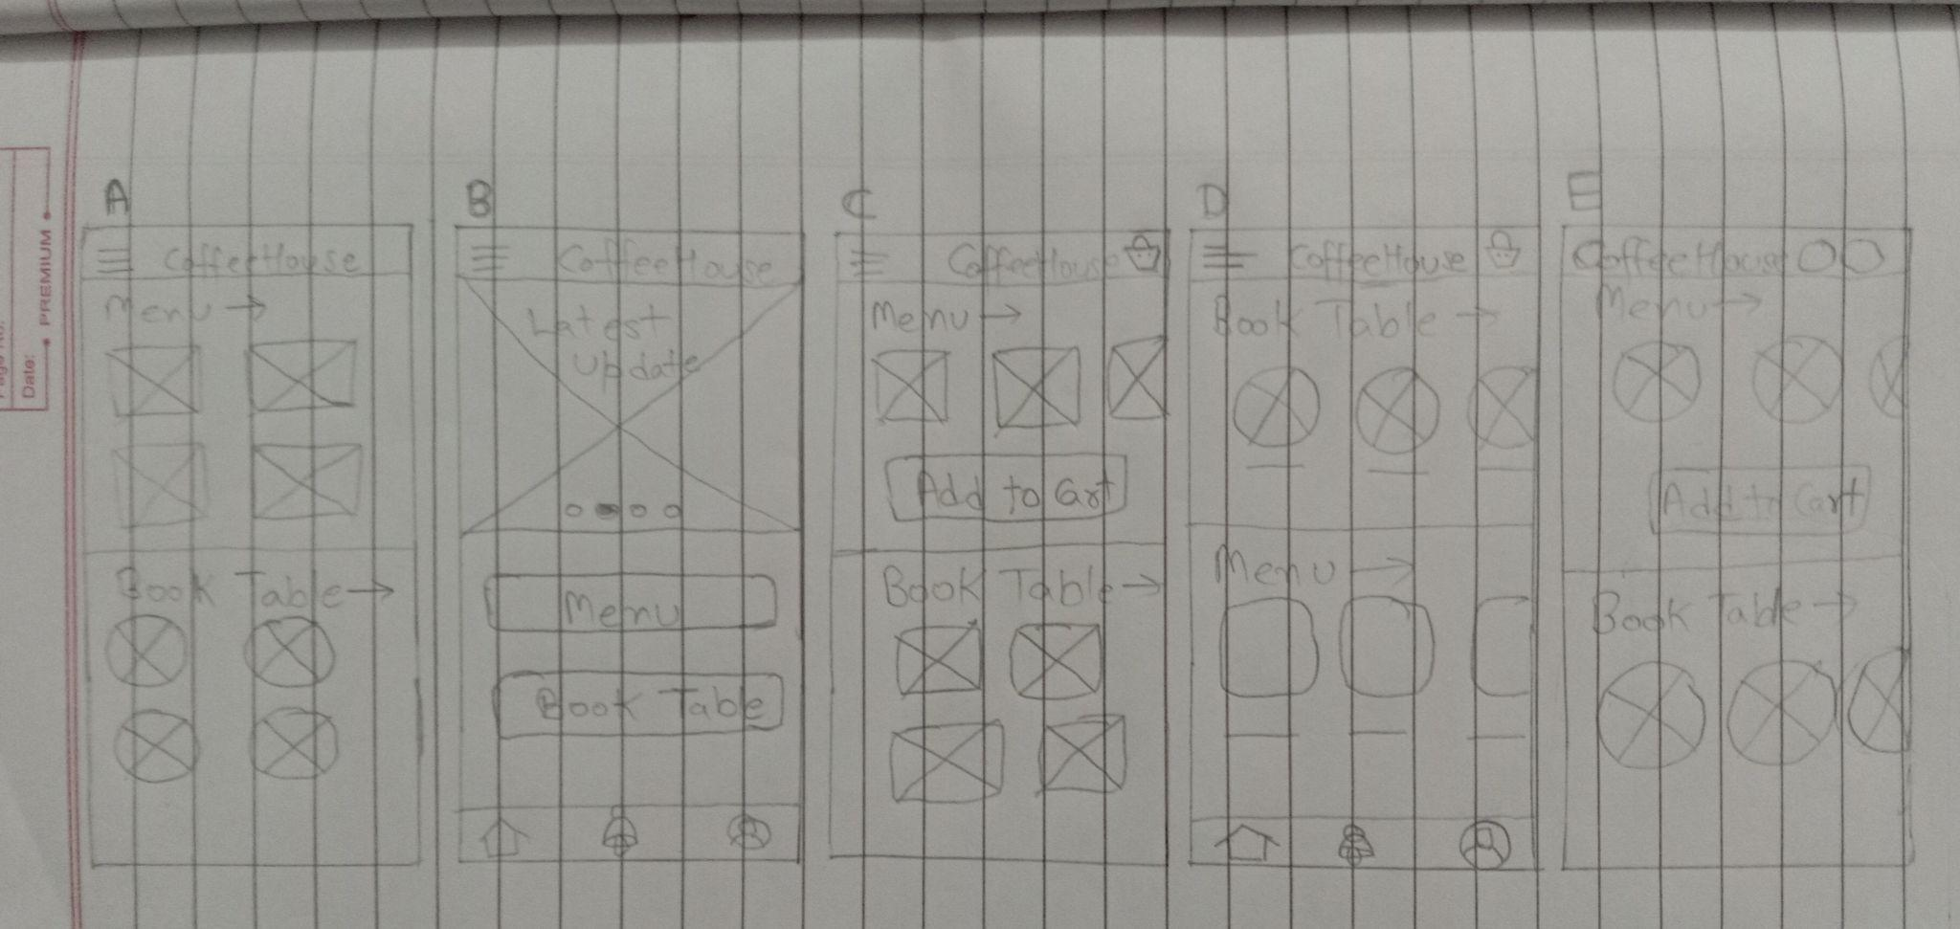
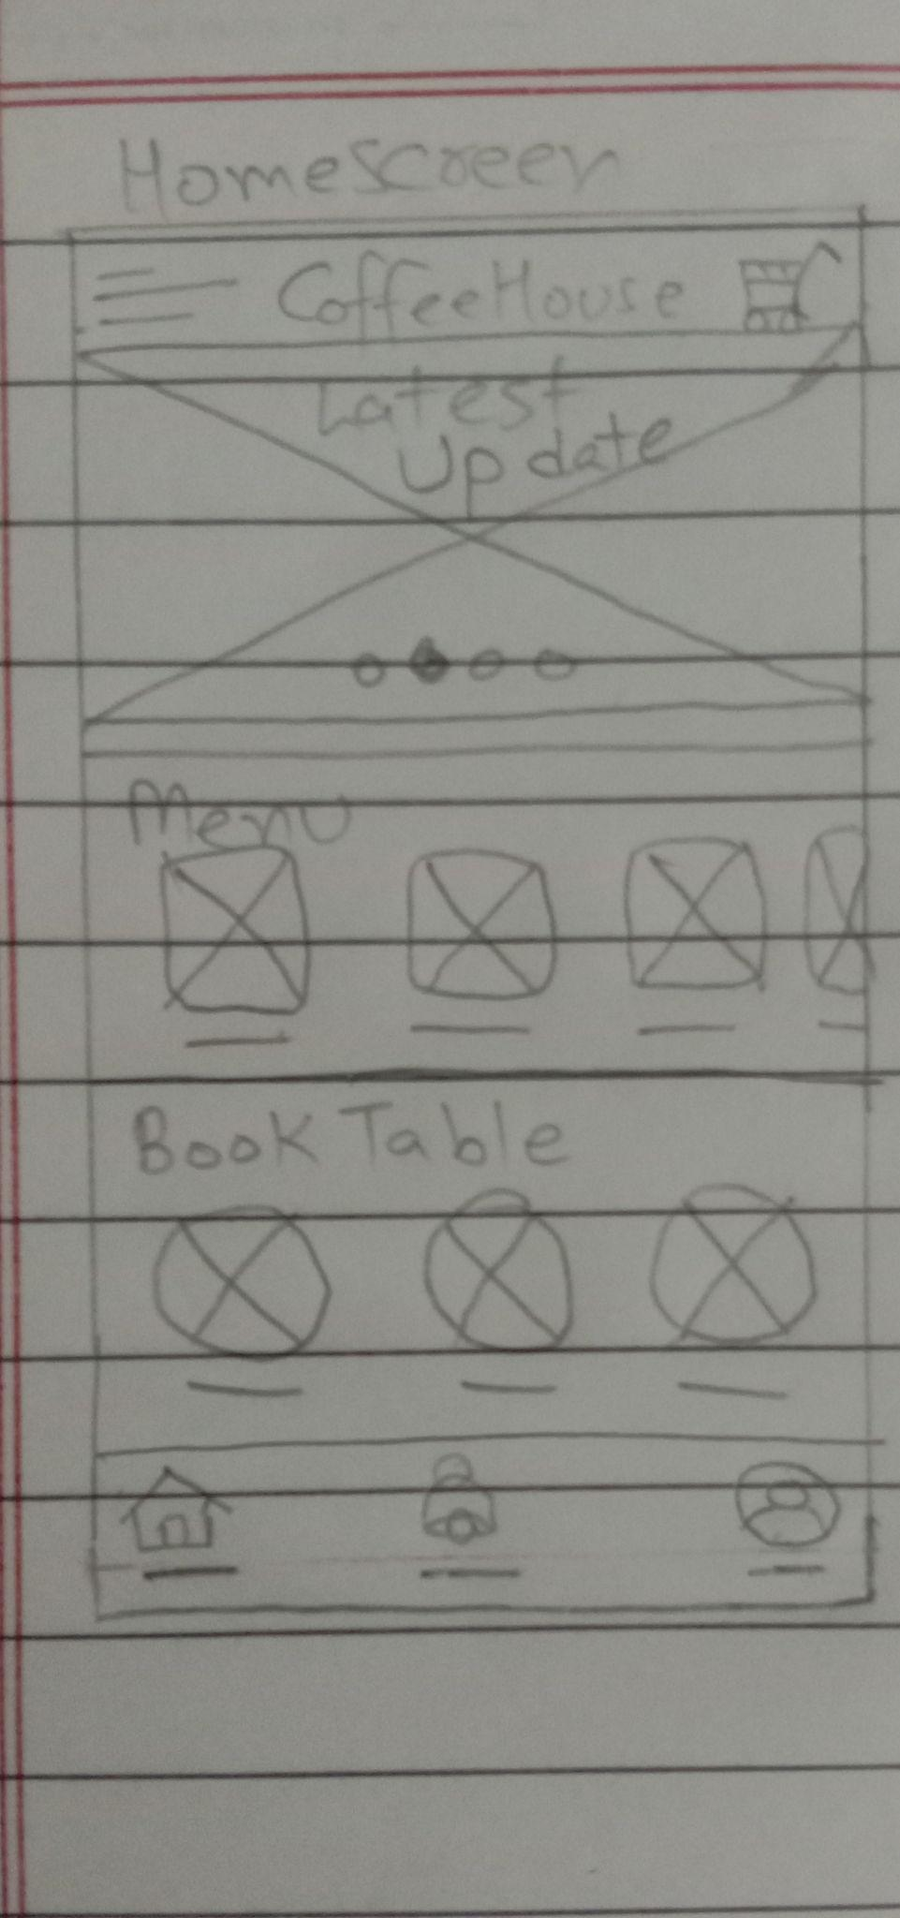
Paper wireframes
Taking the time to draft iterations of each screen of the app on paper ensured that the elements that made it to digital wireframes would be well-suited to address user pain points. For the home screen, I prioritized a quick and easy ordering process and easy reserving process to help users save time.

Slide 12
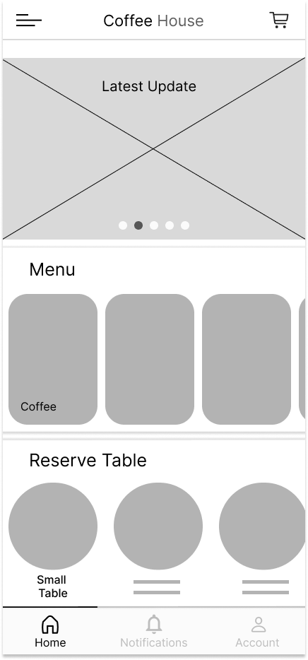
Digital wireframes
As the initial design phase continued, I made sure to base screen designs on feedback and findings from the user research.
This option provides categories of drinks in menu so that user can easily select drink.
This option provides types of table options , so that user can easily select table type.

Slide 13
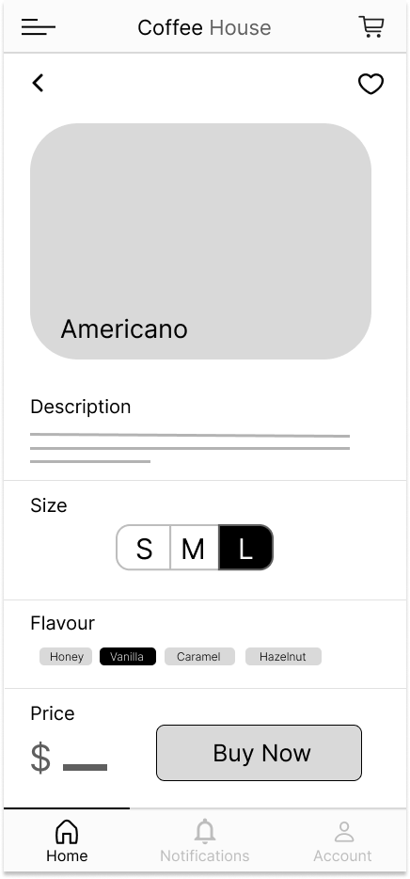
Digital wireframes
Good way to represent Product and making customization easy for the users helps them to interact with app and order their customized drink.
This option provides different sizes of cup for drinks and helps users to easily select the size of cup.
This button provides buying a drink option which helps users to buy customized drink

Slide 14
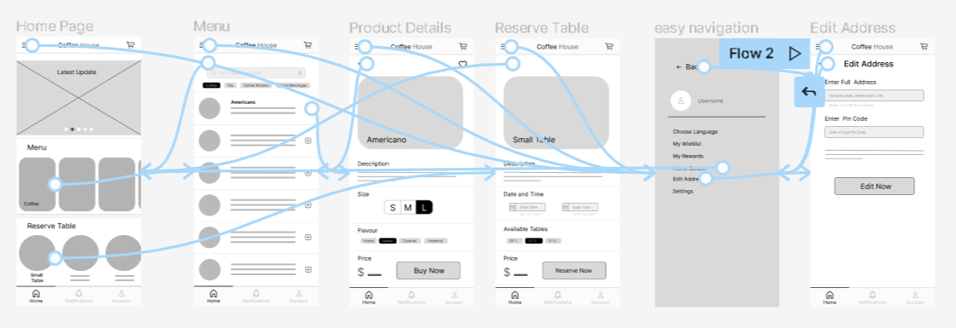
Low-fidelity prototype
Using the completed set of digital wireframes, I created a low-fidelity prototype. The primary user flow I connected were customizing a drink and reserving a table, so the prototype could be used in a usability study.
View the CoffeeHouse App
https://www.figma.com/proto/50LeKfhN785VnTBxYEYdTd/Untitled?node-id=1%3A2&scaling=scale-down&page-id=0%3A1&starting-point-node-id=1%3A2

Slide 15
Usability study: findings
I conducted one round of usability studies. Findings from the first study helped guide the designs from wireframes to mockups.
Round 1 findings
1
User wants account option in header of home screen.
2
User wants clear labels of customization of drinks.
3
User wants calendar option to select date on reservation of table screen.

Slide 16
Refining
the design
Mockups
High-fidelity prototype
Accessibility

Slide 17
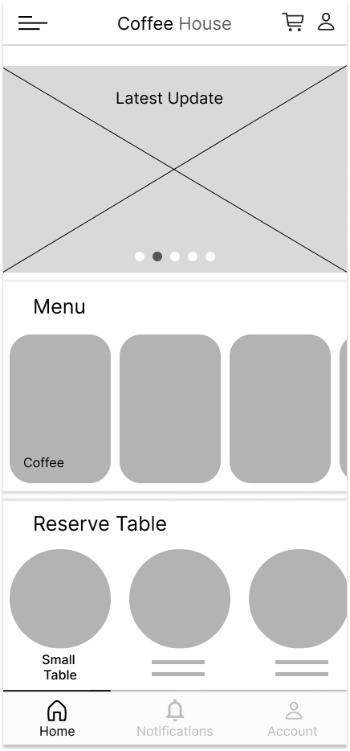
Mockups
Before usability study
After usability study
Early designs only have a account option in bottom navigation bar, but after the usability studies, I added account option in header so that users can easily make account and to make it more accessible.

Slide 18
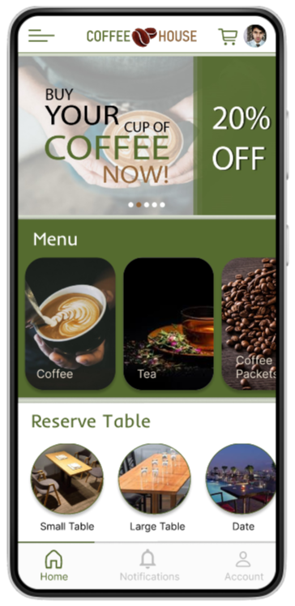
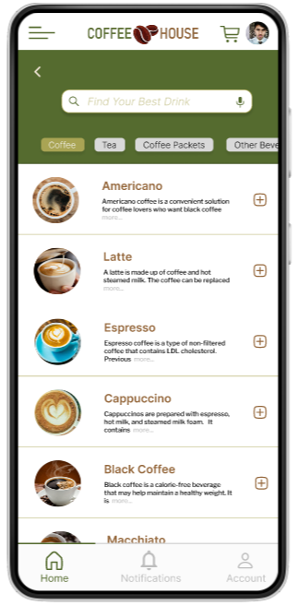
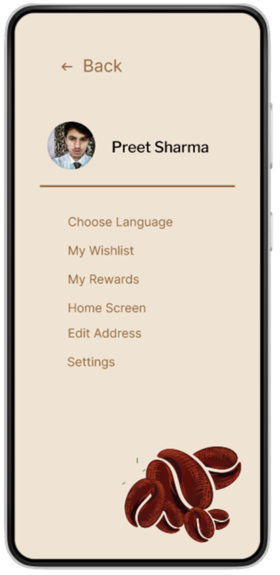
Mockups

Slide 19
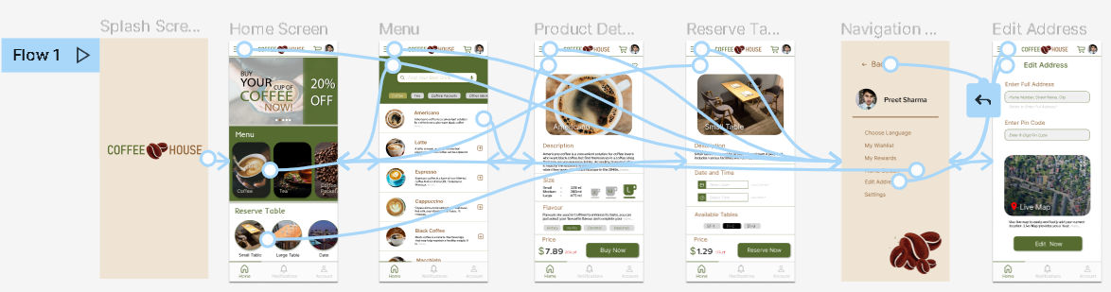
High-fidelity prototype
The final high-fidelity prototype presented cleaner user flows for customizing drinks and reserving tables. It also met user needs for a adding live map and calendar option to app.
View the CoffeeHouse App
https://www.figma.com/proto/kYkgyUNaDNpoy1F84oq8Po/COFFEEHOUSE-APP?node-id=21%3A15&scaling=scale-down&page-id=0%3A1&starting-point-node-id=21%3A10

Slide 20
Accessibility considerations
1
2
3
Provided access to users who are vision impaired through adding alt text to images for screen readers.
Used icons to help make navigation easier.
Used detailed imagery for drinks to help all users better understand the designs.

Slide 21
Going forward
Takeaways
Next steps

Slide 22
Takeaways
Impact:
The app makes users feel like CoffeeHouse really thinks about how to meet their needs.
One quote from peer feedback:
“The app really helpful for me to reserve table in advance so that I need not to wait, I am also impressed with its customization of drinks option, I will definitely use this app.”
What I learned:
While designing the CoffeeHouse app, I learned that the first ideas for the app are only the beginning of the process. Usability studies and peer feedback influenced each iteration of the app’s designs.

Slide 23
Next steps
1
2
Conduct another round of usability studies to validate whether the pain points users experienced have been effectively addressed.
Conduct more user research to determine any new areas of need.

Slide 24
Insert a few sentences summarizing the next steps you would take with this project and why. Feel free to organize next steps in a bullet point list.
Let’s connect!
Thank you for your time reviewing my work on the CoffeeHouse app! If you’d like to see more or get in touch, my contact information is provided below.
Email: preetsharma9699@email.com

